Slide 1
Code Design
Instructor: Account-FSUx

Slide 2
Agenda
Algorithmic Problem Solving
What is an Algorithm?
Pseudo Code
Flowchart
The Structure Theorem

Slide 3
Algorithmic Problem Solving What is an algorithm?
Lists the steps involved in accomplishing a task (like a recipe)
Defined in programming terms as ‘a set of detailed and ordered instructions developed to describe the processes necessary to produce the desired output from a given input’
An algorithm must:
Be lucid, precise and unambiguous
Give the correct solution in all cases
Eventually end

Slide 4
Algorithmic Problem Solving Pseudo Code: What is Pseudo Code?
Detailed and readable description (in structured English) of what a computer program or algorithm must do (states the steps to the problem solution)
Statements are written in simple English
Each instruction/step is written on a separate line
Keywords and indentation are used to signify particular control structures
Each set of instructions is written from top to bottom, with only one entry and one exit
Used as a detailed step in the process of developing a program.
It allows designers or lead programmers to express the design in great detail and provides programmers a detailed template for the next step of writing code in a specific programming language

Slide 5
Algorithmic Problem Solving Pseudo Code: Guidelines 1/3
There are six basic computer operations:
A computer can receive information
A computer can put out information
A computer can perform arithmetic
A computer can assign a value to a variable or memory location
A computer can compare two variables and select one of two alternate actions
A computer can repeat a group of actions
Notes:
1. A computer can receive information
Read (information from a file)
Get (information from the keyboard)
2. A computer can put out information
Write (information to a file)
Display (information to the screen)
3. A computer can perform arithmetic
Use actual mathematical symbols or the words for the symbols
Add number to total
Total = total + number
+, -, *, /
Calculate, Compute also used
4. A computer can assign a value to a piece of data
3 cases
To give data an initial value
Initialize, Set
To assign a value as a result of some processing
‘=’
* x = 5 + y
To keep a piece of information for later use
Save, Store
5. A computer can compare two piece of information and select one of two alternative actions
IF condition THEN
Some action
ELSE
Alternative action
ENDIF
6. A computer can repeat a group of actions
WHILE condition (is true)
Some action
ENDWHILE
FOR a number of times
Some action
ENDFOR

Slide 6
Algorithmic Problem Solving Pseudo Code: Guidelines 2/3
The keywords used for pseudocode in this document are:
for start and finish BEGIN MAINPROGRAM, END MAINPROGRAM
for initialisation INITIALISATION, END INITIALISATION
for subprogram BEGIN SUBPROGRAM, END SUBPROGRAM
for selection IF, THEN, ELSE, ENDIF
for multi-way selection CASEWHERE, OTHERWISE, ENDCASE
for pre-test repetition WHILE, ENDWHILE
for post-test repetition REPEAT, UNTIL

Slide 7
Algorithmic Problem Solving Pseudo Code: Guidelines 3/3
Keywords are written in CAPITALS.
Structural elements come in pairs, e.g.
for every BEGIN there is an END
for every IF there is an ENDIF, etc.
Indenting is used to show structure in the algorithm.
The names of subprograms are underlined.
This means that when refining the solution to a problem, a word in an algorithm can be underlined and a subprogram developed.
This feature enables the use of the ‘top-down’ development concept, where details for a particular process need only be considered within the relevant sub-routine.

Slide 8
Algorithmic Problem Solving Flowchart - Overview
A diagrammatic representation that illustrates the sequence of operations to be performed to get the solution of a problem.
Generally drawn in the early stages of formulating computer solutions.
Facilitate communication between programmers and business people.
Play a vital role in the programming of a problem
Are quite helpful in understanding the logic of complicated and lengthy problems.
Once the flowchart is drawn, it becomes easy to write the program in any high level language.
Often we see how flowcharts are helpful in explaining the program to others. Hence, it is correct to say that a flowchart is a must for the better documentation of a complex program.

Slide 9




Algorithmic Problem Solving Flowchart - Basic Flowchart Symbols
Rounded box - use it to represent an event which occurs automatically. Such an event will trigger a subsequent action, for example `receive telephone call’, or describe a new state of affairs.
Rectangle or box - use it to represent an event which is controlled within the process. Typically this will be a step or action which is taken. In most flowcharts this will be the most frequently used symbol.
Diamond - use it to represent a decision point in the process. Typically, the statement in the symbol will require a `yes' or `no' response and branch to different parts of the flowchart accordingly.
Circle - use it to represent a point at which the flowchart connects with another process. The name or reference for the other process should appear within the symbol.

Slide 10
Algorithmic Problem Solving Flowchart - Sample
start
Assignment name?
Pseudocode
Start Program
Prompt for assignment
Set a counter
Loop through grades
Get student grade
Increment counter
End loop
Calculate Average
Print Average
End Program
Set counter = 1
Counter>10?
Student Grade?
Yes
No
Increment Counter
Calculate Average
Print Average
end

Slide 11
Algorithmic Problem Solving Flow Chart - Practice Time...
Practice 1
Draw a flowchart to find the largest of three numbers A,B, and C
Practice 2
Draw a flowchart to find the sum of first 50 natural numbers

Slide 12
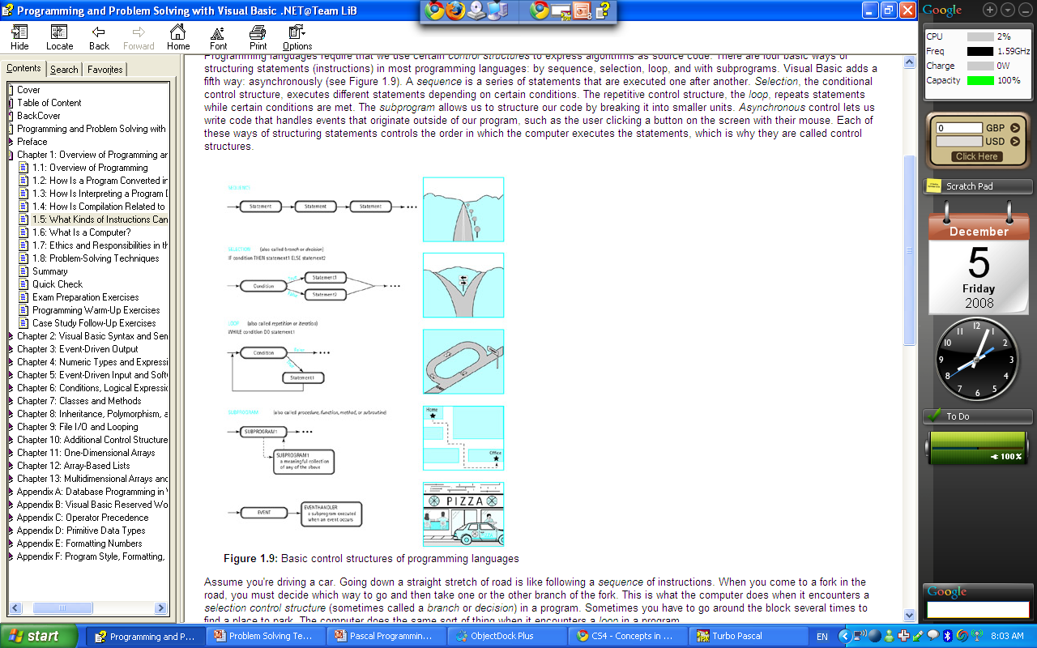
Algorithmic Problem Solving The Structure Theorem – Overview (1/3)
Three basic rules
1) Sequence
Get up from bed
Dress up
Go to the shower
Go to work
2) Selection
If car is broken, go to work by bus. Otherwise go to work by car
3) Repetition
Drink until the bottle is empty

Slide 13
Algorithmic Problem Solving The Structure Theorem – Overview 2/3
It is considered good practice for a single flowchart: never to exceed the bounds of one page.
If a flowchart does not fit on one page:
this is one instance in which the better solution is to use refinement
which results in the creation of subprograms.
Subprograms on separate pages are more desirable than using a connector to join flowcharts over more than one page.
A flowchart expressing the solution to an involved problem may have:
the main program flowchart on one page
with subprograms continuing the problem solution on subsequent pages.
Regardless of page size, it is also important to start any complex algorithm with:
a clear, uncluttered main line.
This should reference the required subroutines
whose detail is shown in separate flowcharts.

Slide 14
Algorithmic Problem Solving The Structure Theorem – Overview 3/3
Each of the five acceptable structures can be built from the basic elements.
In all cases note there is:
only one entry point to the structure
and one exit point as indicated by the dashed boxes.
Since each structure can be thought of as a process
More complex algorithms can be constructed by: replacing any single process by one or other of the structures.

Slide 15
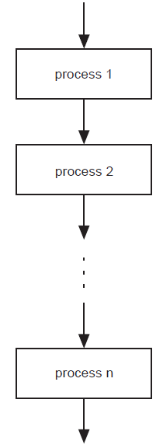
Algorithmic Problem Solving The Structure Theorem - Sequence
In a computer program or an algorithm, sequence involves simple steps which are to be executed one after the other. The steps are executed in the same order in which they are written.
In pseudocode,
sequence is expressed as:
process 1
process 2
…
…
process n
In a flowchart,
sequence is expressed as:
(The arrowheads are optional if the flow is top-to-bottom.)

Slide 16
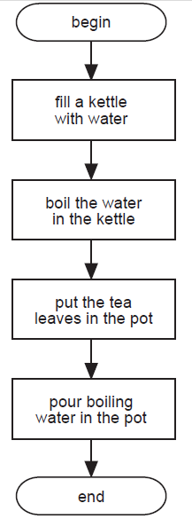
Algorithmic Problem Solving The Structure Theorem – Sequence Example
An Example Using Sequence
Problem: Write a set of instructions that describe how to make a pot of tea.
Pseudocode
BEGIN
fill a kettle with water
boil the water in the kettle
put the tea leaves in the pot
pour boiling water in the pot
END
Flowchart

Slide 17
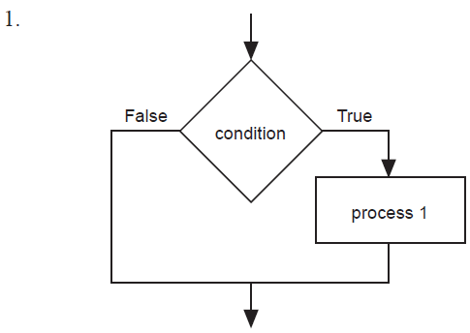
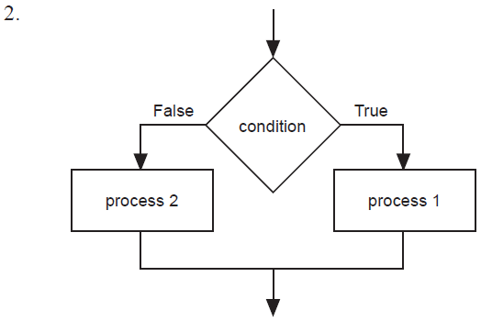
Algorithmic Problem Solving The Structure Theorem – Binary Selection 1/2
If the condition is met then one path is taken, otherwise the second possible path is followed.
Pseudocode
IF condition THEN
process 1
ENDIF
IF condition THEN
process 1
ELSE
process 2
ENDIF
Flowcharts
Flowcharts

Slide 18
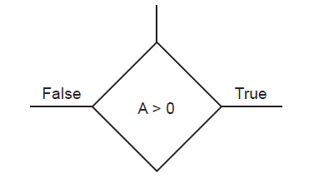
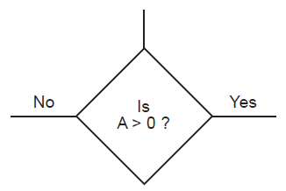
Algorithmic Problem Solving The Structure Theorem – Binary Selection 2/2
Note:
In a flowchart it is most important to indicate
which path is to be followed when the condition is true, and
which path to follow when the condition is false.
There are two acceptable ways to represent a decision in all of the structures.
Either method is acceptable. For consistency, the method 1 is used throughout this document.
The condition is expressed as a statement and the two possible outcomes are indicated by
True
False
2. The condition is expressed as a question and the two possible outcomes are indicated by
Yes
No

Slide 19
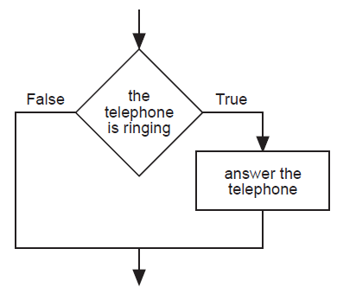
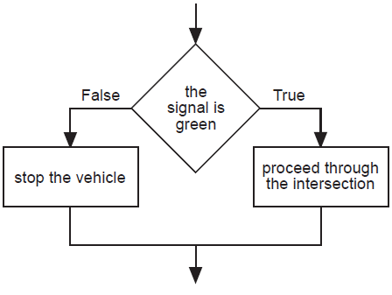
Algorithmic Problem Solving The Structure Theorem – Binary Selection Examples
Examples Using Binary Selection
Problem 1: Write a set of instructions to describe when to answer the phone.
Problem 2: Write a set of instructions to follow when approaching a set of traffic control lights.
Pseudocode
IF the telephone is ringing THEN
answer the telephone
ENDIF
Pseudocode
IF the signal is green THEN
proceed through the intersection
ELSE
stop the vehicle
ENDIF
Flowchart
Flowchart

Slide 20
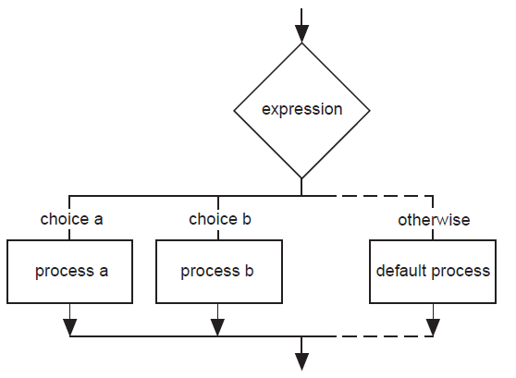
Algorithmic Problem Solving The Structure Theorem – Multi-way Selection
Multi-way selection allows for any number of possible choices, or cases. The path taken is determined by the selection of the choice which is true.
Multi-way selection is often referred to as a case structure.
Pseudocode
CASEWHERE expression evaluates to
choice a : process a
choice b : process b
. .
. .
. .
OTHERWISE : default process
ENDCASE
Note: As the flowchart version of the multi-way selection indicates, only one process on each pass is executed as a result of the implementation of the multi-way selection.
Flowcharts

Slide 21
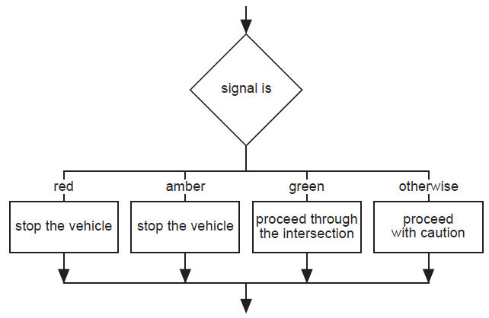
Algorithmic Problem Solving The Structure Theorem – Multi-way Selection Examples
Example Using Multi-way Selection
Problem: Write a set of instructions that describes how to:
respond to all possible signals at a set of traffic control lights.
Pseudocode
CASEWHERE signal is
red : stop the vehicle
amber : stop the vehicle
green : proceed through the intersection
OTHERWISE : proceed with caution
ENDCASE
Flowchart

Slide 22
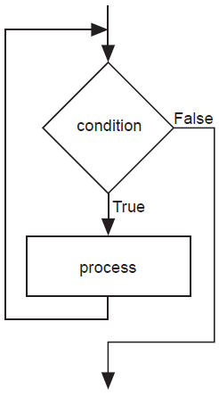
Algorithmic Problem Solving The Structure Theorem – Repetition
Repetition allows for a portion of an algorithm or computer program to be done any number of times dependent on some condition being met.
An occurrence of repetition is usually known as a loop.
Repetition: Pre-Test
This construct is often called a guarded loop.
The body of the loop is executed repeatedly while the termination condition is true.
Pseudocode
WHILE condition is true
process(es)
ENDWHILE
Flowchart

Slide 23
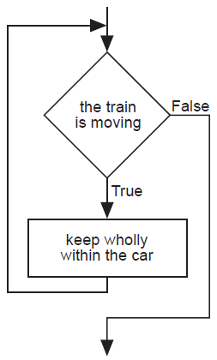
Algorithmic Problem Solving The Structure Theorem – Repetition Examples
An Example Using Pre-Test Repetition
Problem: Determine a safety procedure for travelling in a carriage on a moving train.
Pseudocode
WHILE the train is moving
keep wholly within the carriage
ENDWHILE
Flowchart

Slide 24
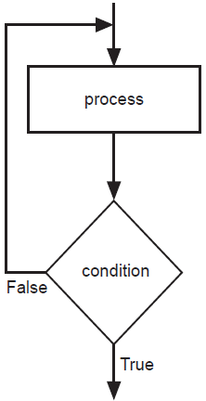
Algorithmic Problem Solving The Structure Theorem – Repetition
Repetition: Post-Test
A post-tested loop executes the body of the loop before testing the termination condition.
This construct is often referred to as an unguarded loop.
The body of the loop is repeatedly executed until the termination condition is true.
An important difference between a pre-test and post-test loop is that the statements of a post-test loop are executed at least once even if the condition is originally true, whereas the body of the pre-test loop may never be executed if the termination condition is originally true.
A close look at the representations of the two loop types makes this point apparent.
Pseudocode
REPEAT
process
UNTIL condition is true
Flowchart

Slide 25
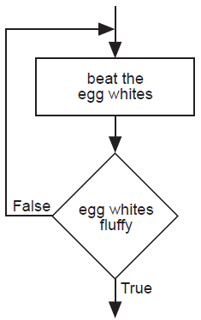
Algorithmic Problem Solving The Structure Theorem – Repetition Examples
An Example Using Post-Test Repetition
Problem: Determine a procedure to beat egg whites until fluffy.
Pseudocode
REPEAT
beat the egg whites
UNTIL fluffy
Flowchart

Slide 26
Algorithmic Problem Solving Pseudo codes - Practice Time…
Practice 3 - Write an algorithm with pseudo codes
Request the user to input two numbers. If the sum of those numbers are greater than 12, program outputs "Big numbers you gave". Otherwise the program outputs "Small numbers you gave"
Practice 4 – Write an algorithm with pseudo codes
Computing Weekly Wages;
Gross pay depends on the pay rate and the number of hours worked per week. However, if you work more than 40 hours, you get paid time-and-a-half for all hours worked over 40. Pseudo-code the task of computing gross pay given pay rate and hours worked.

Slide 27
Algorithmic Problem Solving Pseudo codes - Practice Time…
Practice 5
Pseudo-code the task of computing the final price of an item after figuring in sales tax.
Note the three types of instructions: input (get), process/calculate (=) and output (display)
Note that the operations are numbered and each operation is unambiguous and effectively computable. We also extract and list all variables used in our pseudo-code. This will be useful when translating pseudo-code into a programming language

Slide 28
Algorithmic Problem Solving The Structure Theorem – Subprograms 1/3
Subprograms, as the name implies, are complete part-programs that are used from within the main program section.
When using subprograms it is important that
The solution expression indicates where the main program branches to a subprogram.
It is equally important to indicate exactly where the subprogram begins.
In pseudocode, the statement in the main program that is expanded in a subprogram is underlined to indicate that further explanation follows.
The expanded subprogram section should be identified by
using the keywords BEGIN SUBPROGRAM
followed by the underlined title used in the main program.
The end of the subprogram is marked by the keywords END SUBPROGRAM
and the underlined title used in the main program.
When using flowcharts, a subprogram is shown by an additional vertical line on each side of the process box.

Slide 29
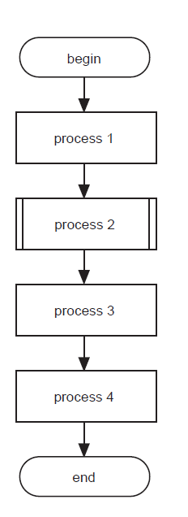
Algorithmic Problem Solving The Structure Theorem – Subprograms 2/3
Subprograms, as the name implies, are complete part-programs
that are used from within the main program section.
Subprograms
Pseudocode
BEGIN MAINPROGRAM
process l
process 2
process 3
process 4
END MAINPROGRAM
BEGIN SUBPROGRAM process 2
do this
do that
END SUBPROGRAM process 2
Subprograms
Flowchart

Slide 30
Algorithmic Problem Solving The Structure Theorem – Subprograms 3/3
In many cases a subprogram can be written to do the same task at two or more points in an algorithm.
Each time the subprogram is called, it may operate on different data.
To indicate the data to be used one or more parameters are used.
The parameters allow the author to write a general algorithm using the formal parameters.
When the subprogram is executed, the algorithm carries out its task on the actual parameters given at the call.
The parameters to be used by a subprogram are provided as a list in parentheses after the name of the subprogram.
There is no need to include them at the end of the algorithm.
Example of Using Subprograms with one Parameter in Pseudocode
BEGIN MAINPROGRAM
read (name)
read (address)
END MAINPROGRAM
BEGIN SUBPROGRAM read (array)
Set pointer to first position
Get a character
WHILE there is still more data AND there is room in the array
store data in the array at the position given by the pointer
Increment the pointer
get data
ENDWHILE
END SUBPROGRAM read (array)
The first time that the subprogram ‘read’ is called:
the characters are read into the array called ‘name’
the second time, the data (characters) are read into the array called ‘address’.

Slide 31
Q & A

